Slide 1
Contrafact Detection Analysis (I Got Rhythm)
26-July-2022

Slide 2
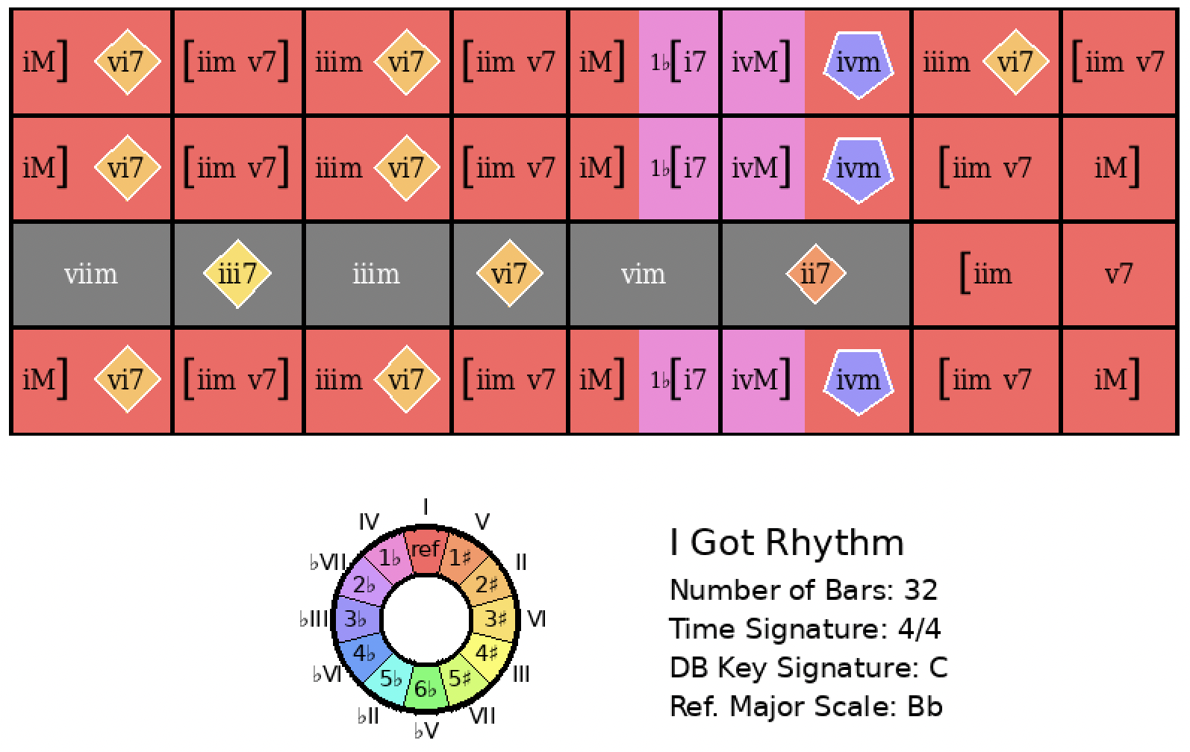
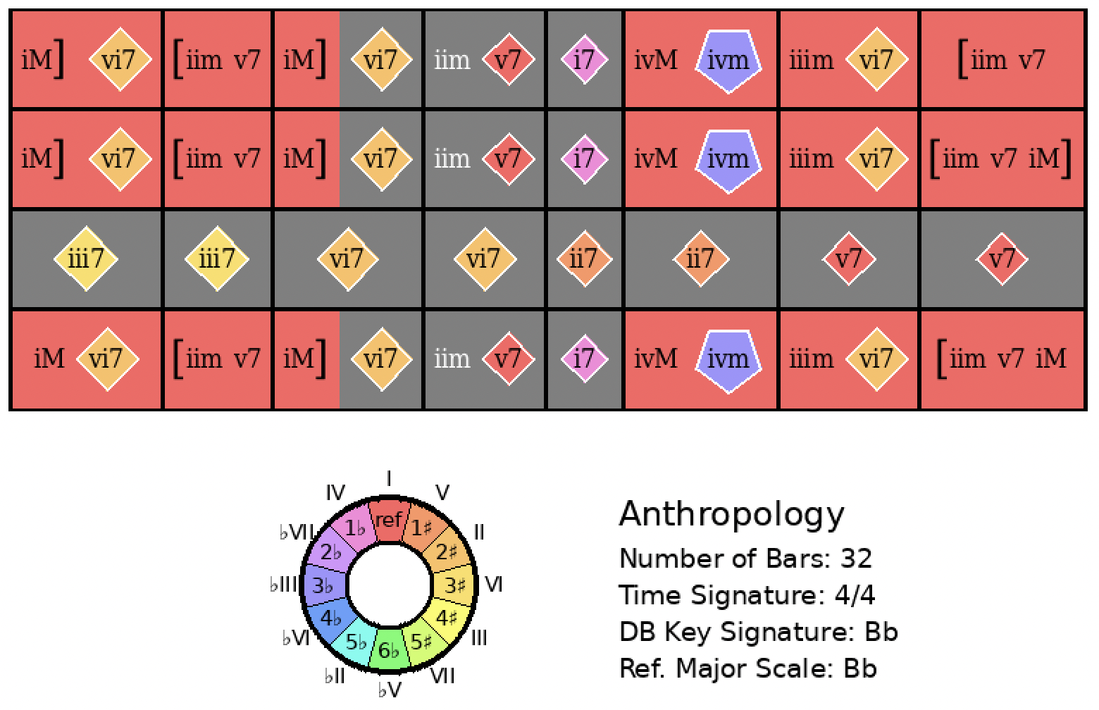
I Got Rhythm
Rank = 4, Area = 8.70

Slide 3
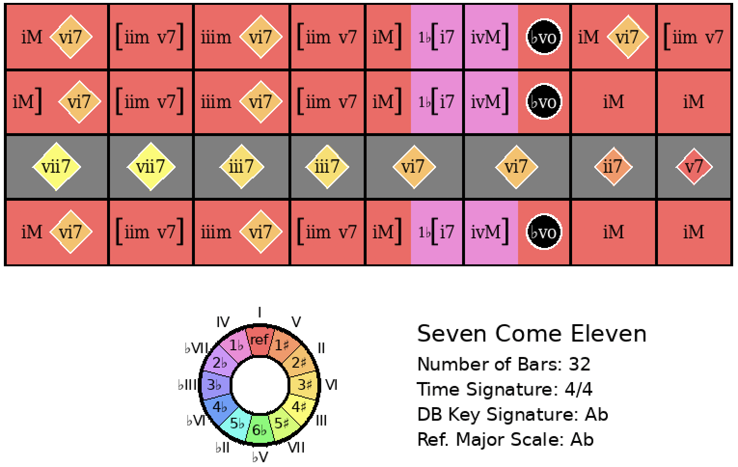
I Got Rhythm
Rank = 5, Area = 9.93

Slide 4
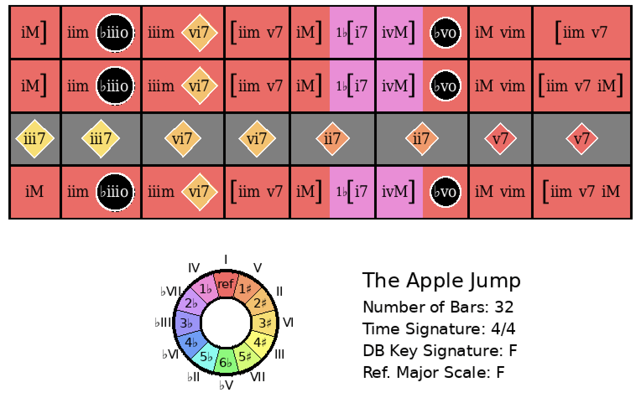
I Got Rhythm
Rank = 10, Area = 13.68

Slide 5
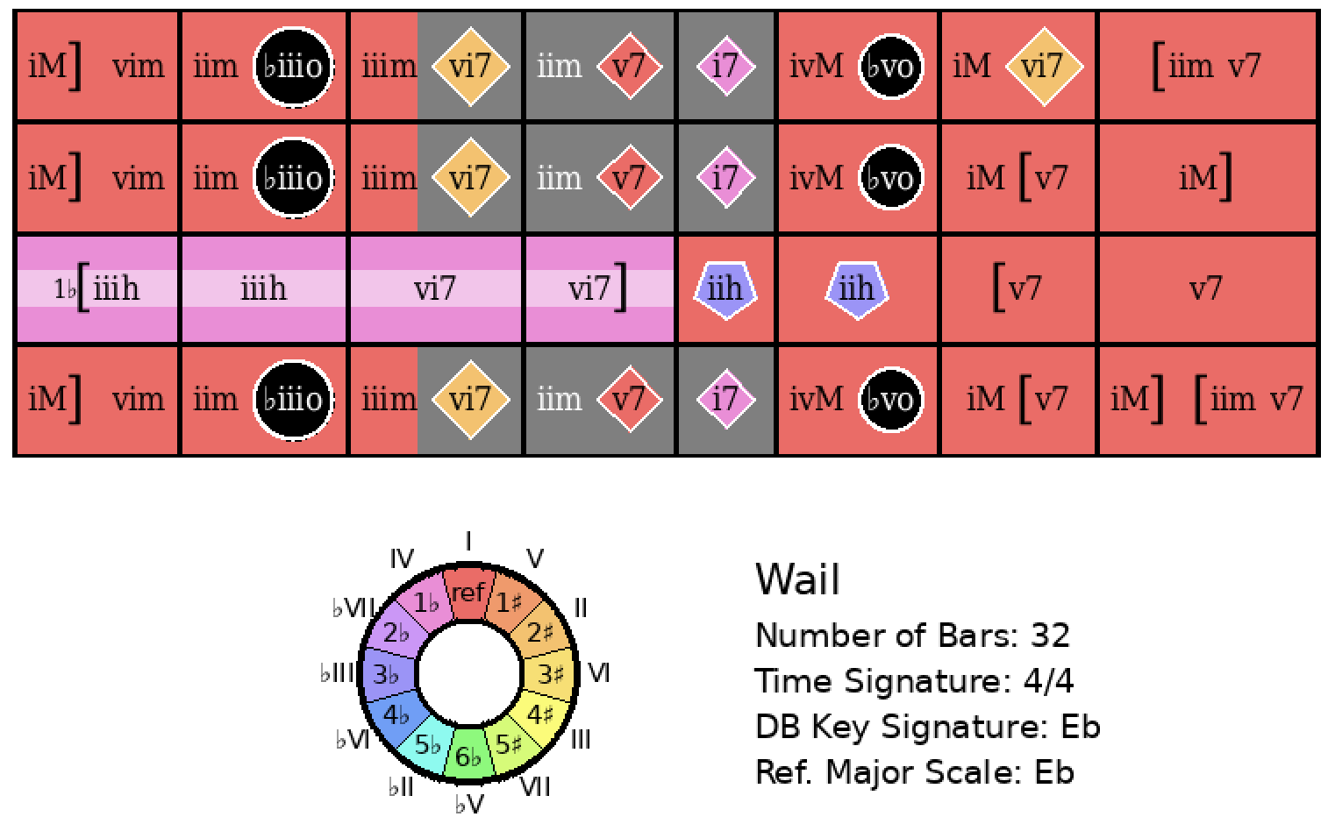
I Got Rhythm
Rank = 12, Area = 13.94

Slide 6
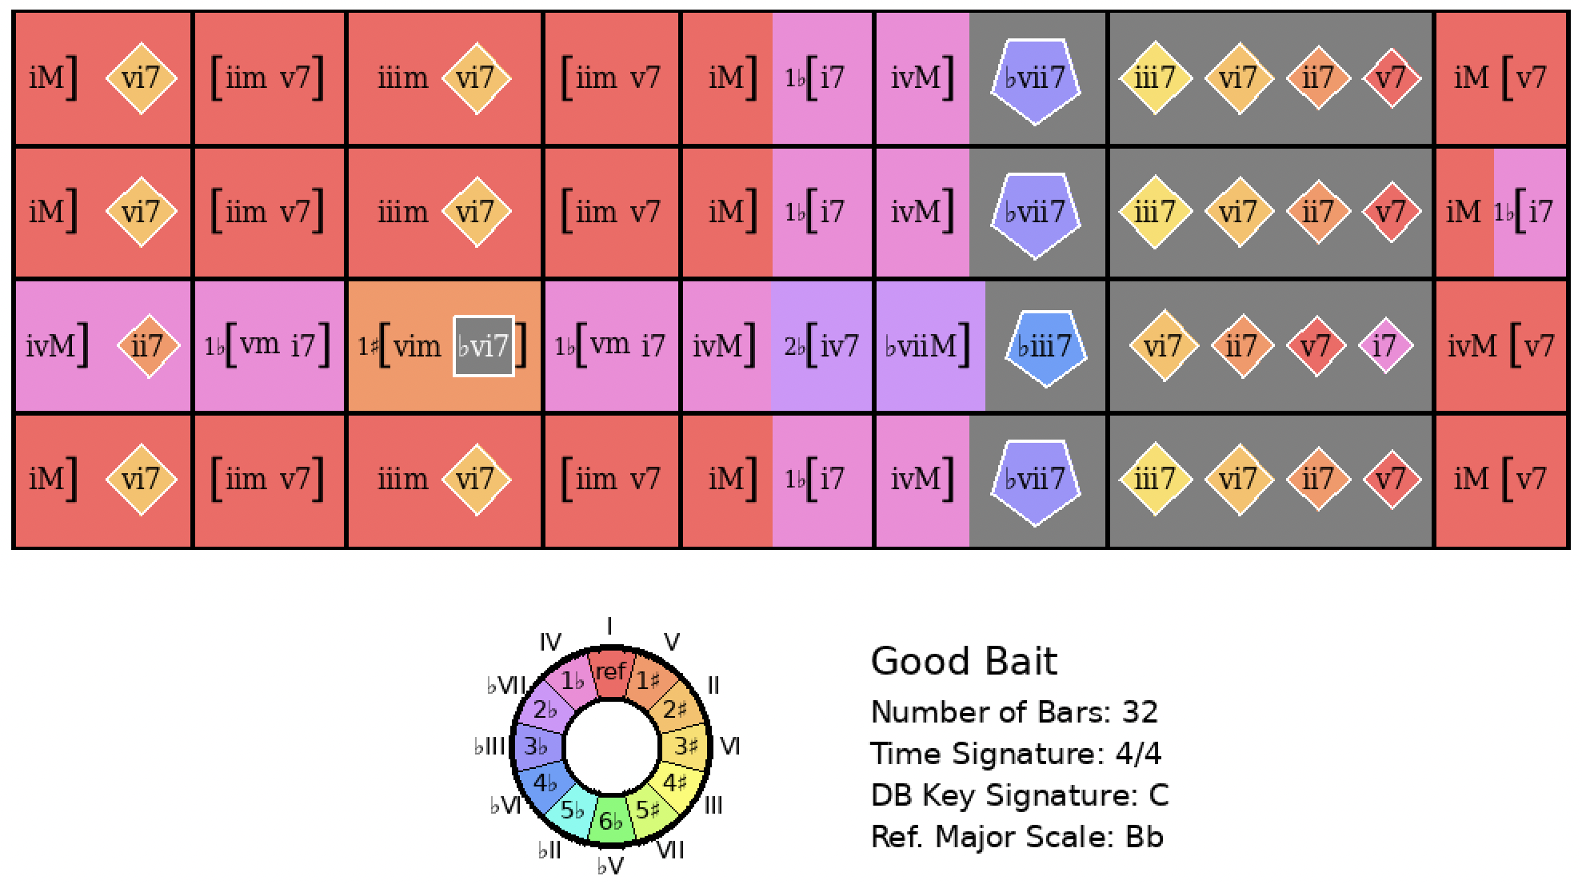
I Got Rhythm
Rank = 24, Area = 15.02

Slide 7
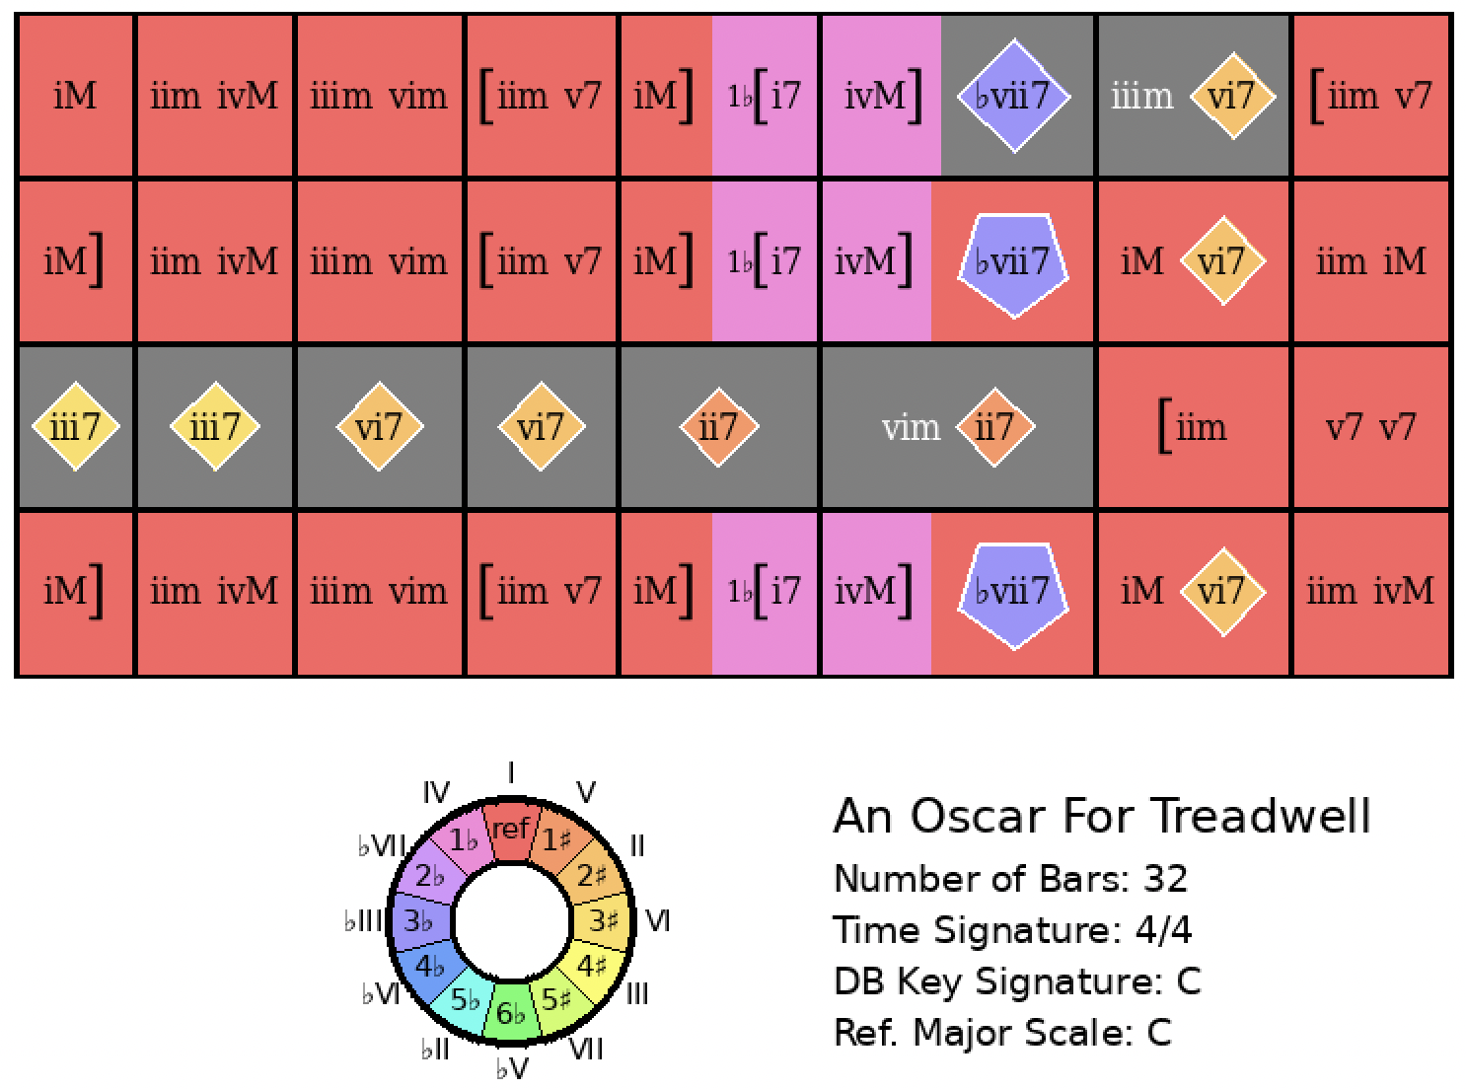
I Got Rhythm
Rank = 25, Area = 15.18

Slide 8
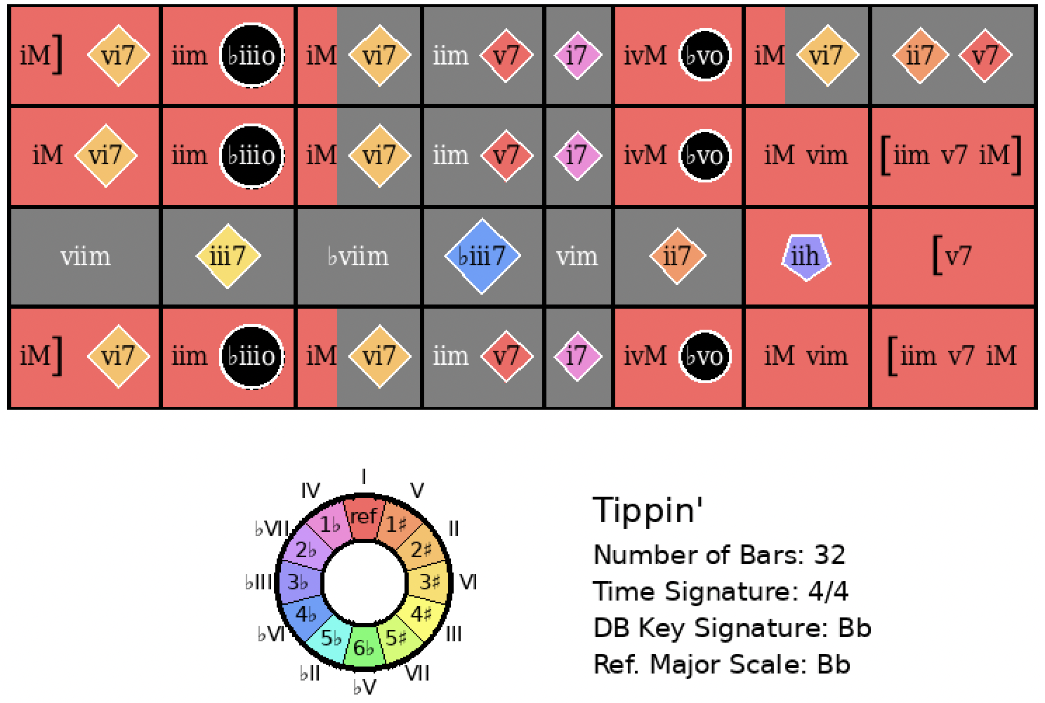
I Got Rhythm
Rank = 30, Area = 15.43

Slide 9
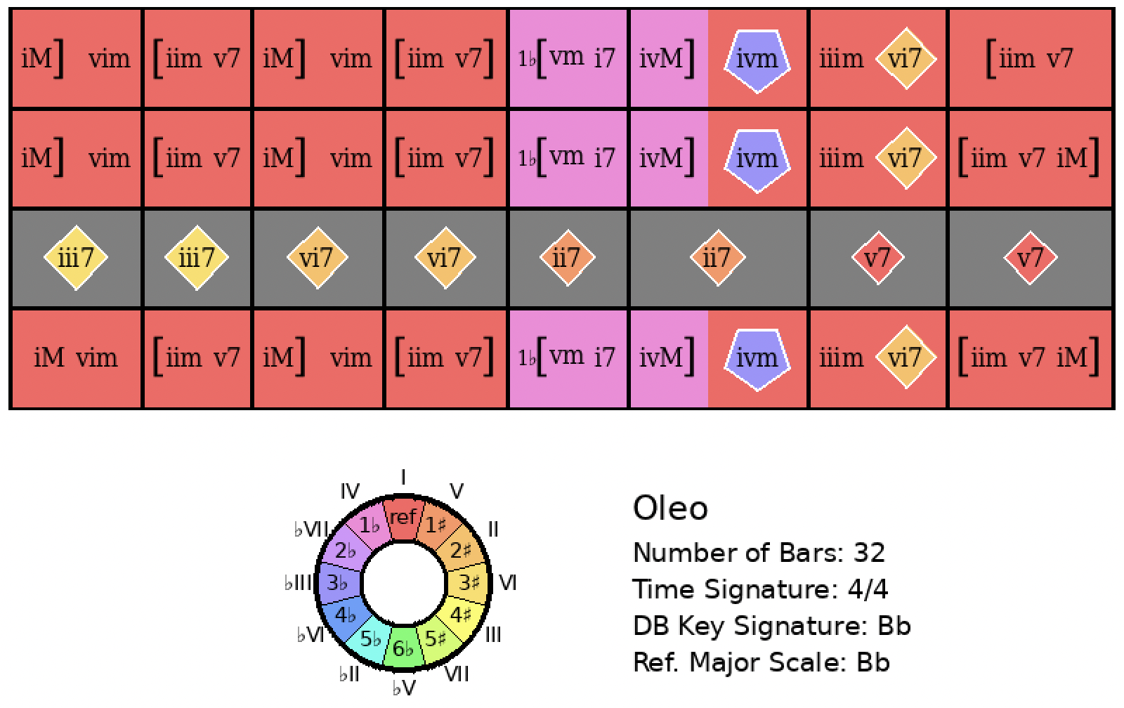
I Got Rhythm
Rank = 71, Area = 17.80

Slide 10
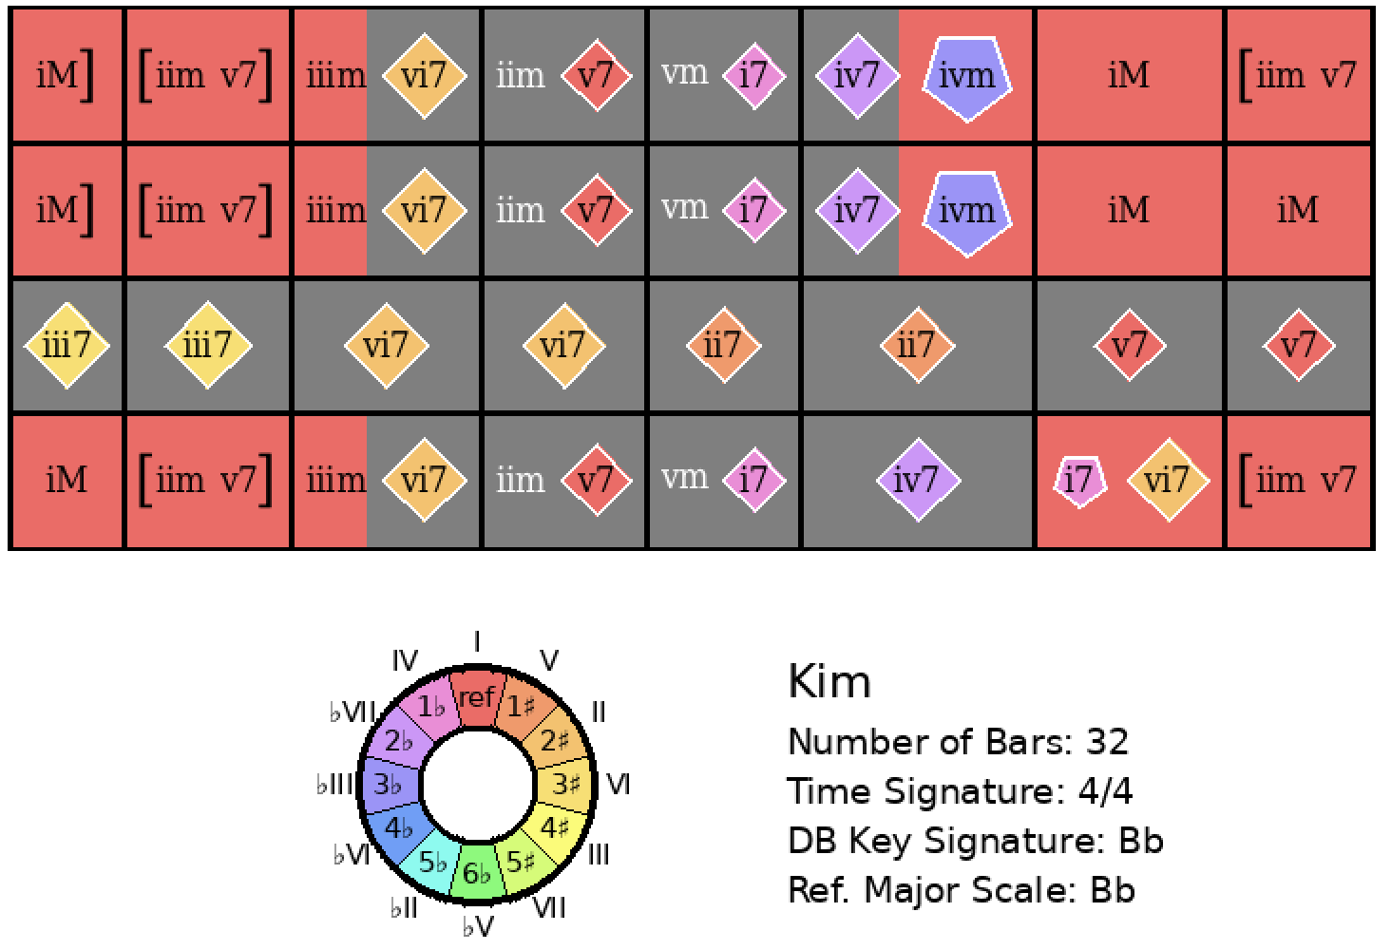
I Got Rhythm
Rank = 72, Area = 17.89

Slide 11
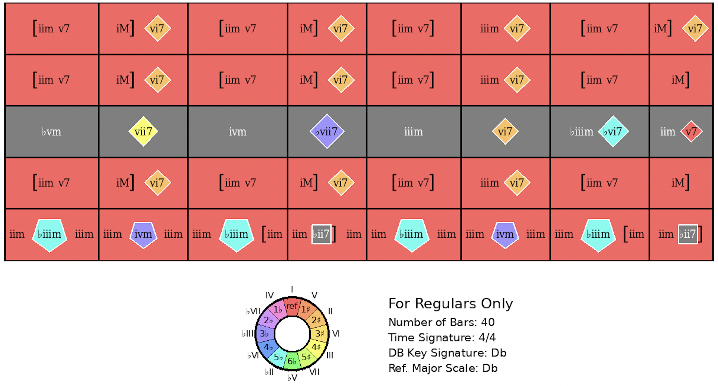
I Got Rhythm
Rank = 108, Area = 19.31

Slide 12
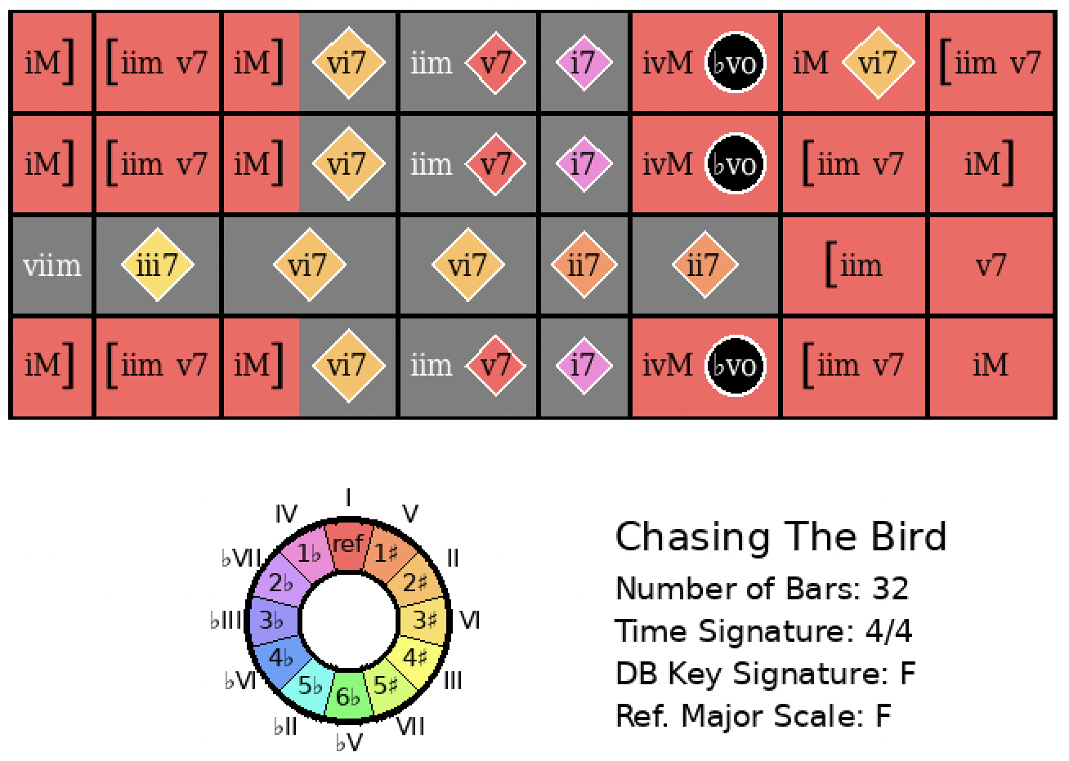
I Got Rhythm
Rank = 121, Area = 19.65

Slide 13
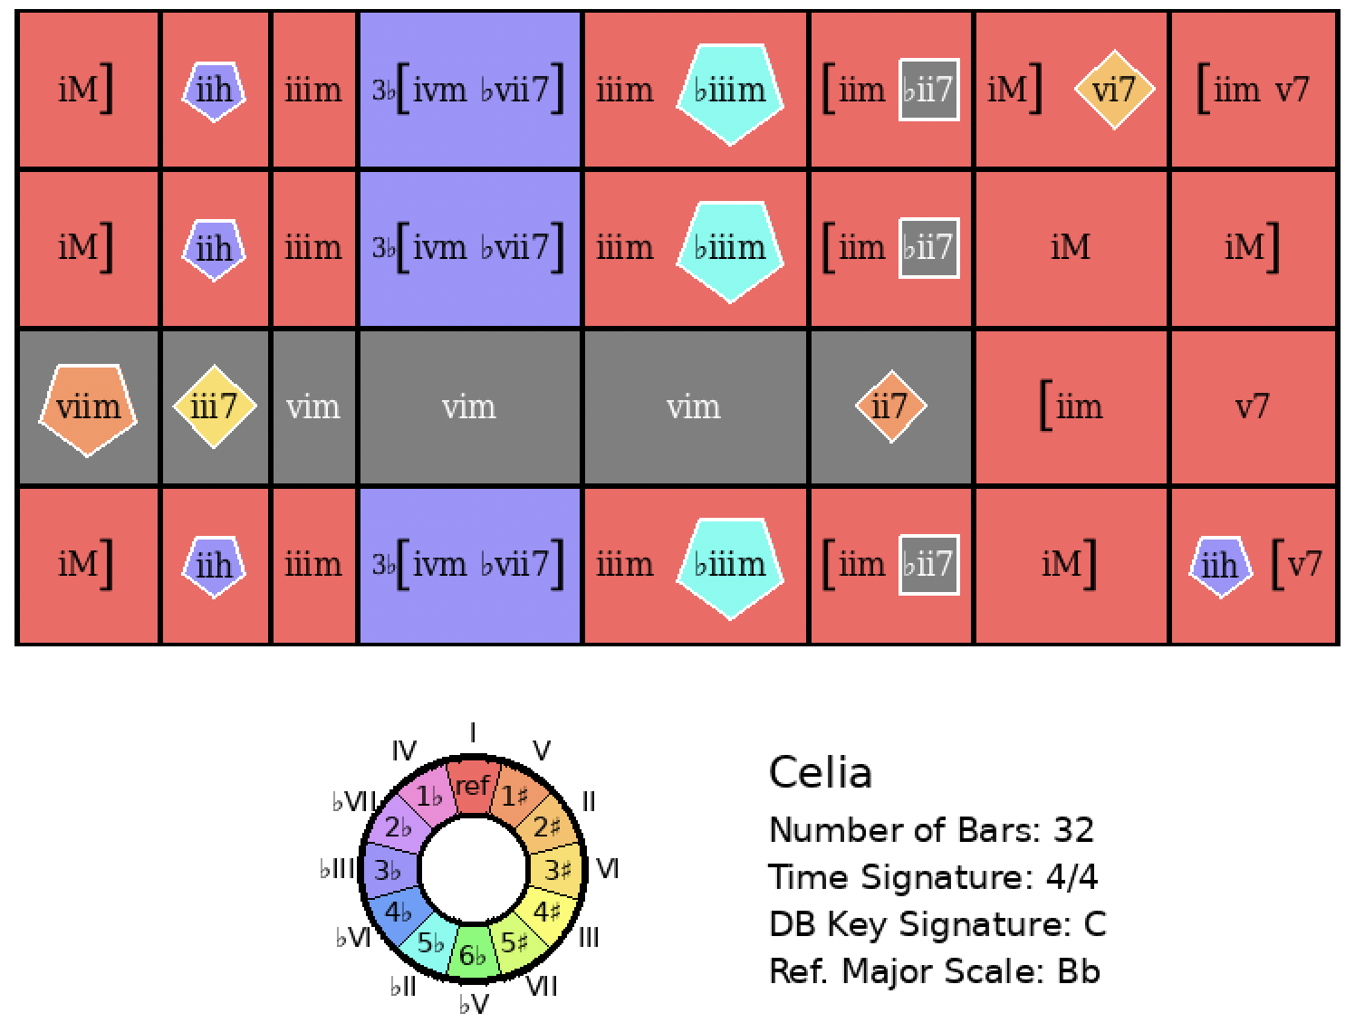
I Got Rhythm
Rank = 165, Area = 20.63

Slide 14
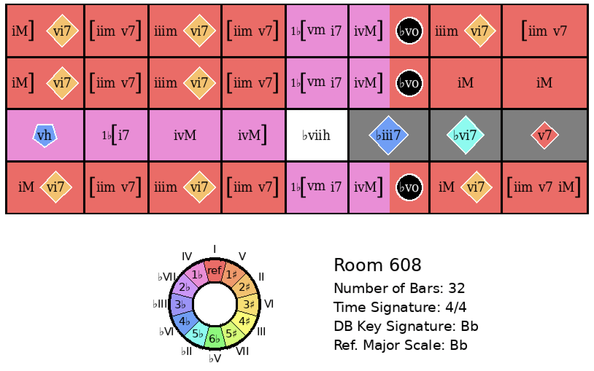
I Got Rhythm
Rank = 171, Area = 20.73

Slide 15
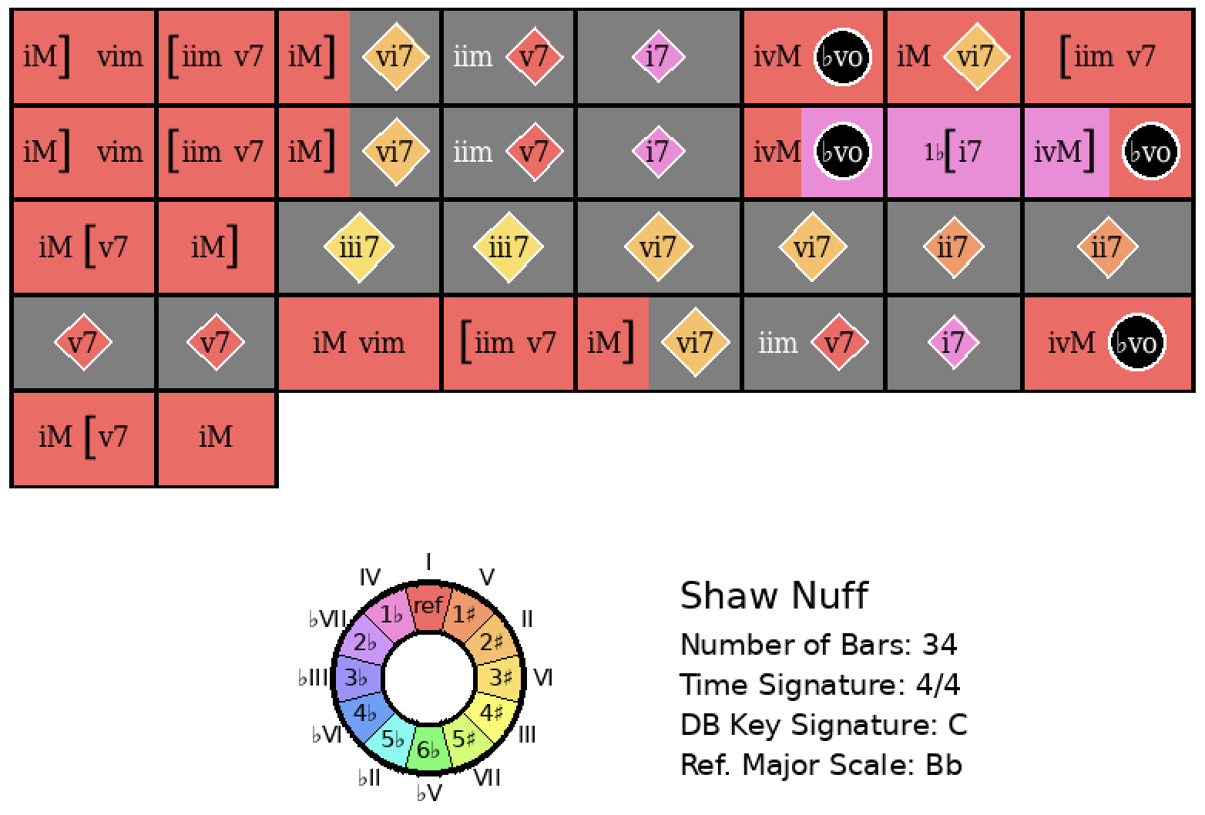
I Got Rhythm
Rank = 181, Area = 20.93

Slide 16
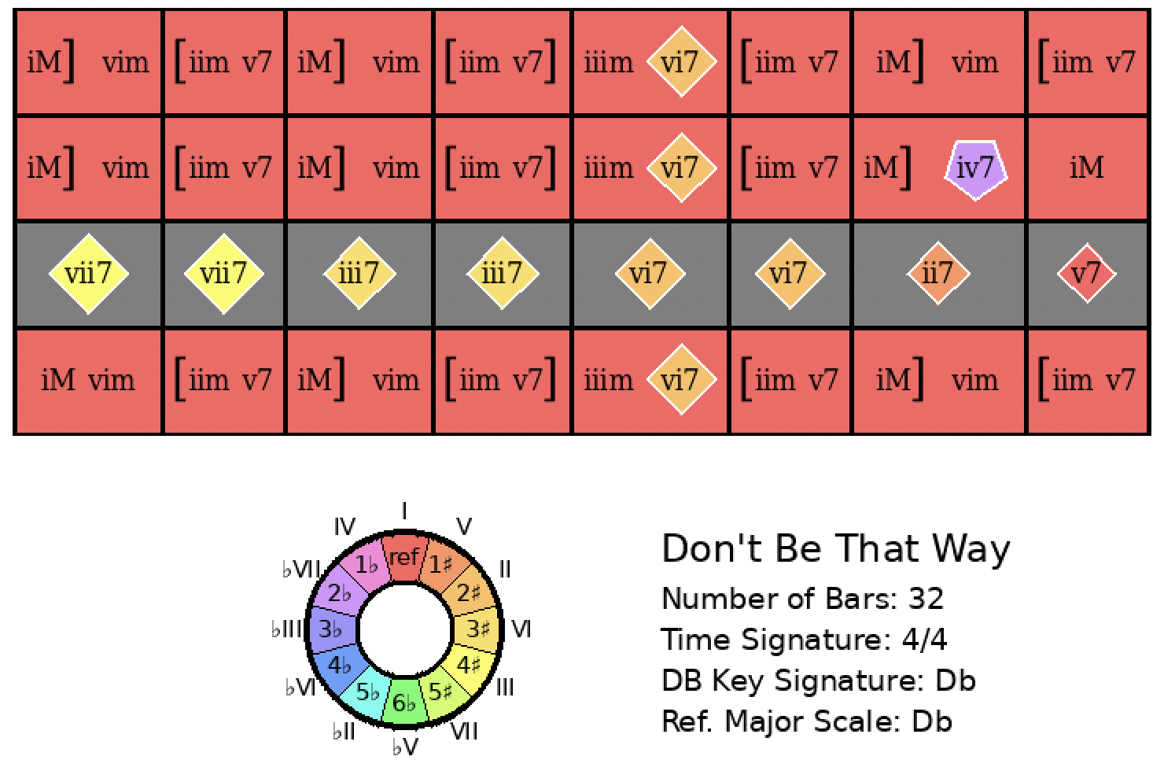
I Got Rhythm
Rank = 199, Area = 21.30

Slide 17
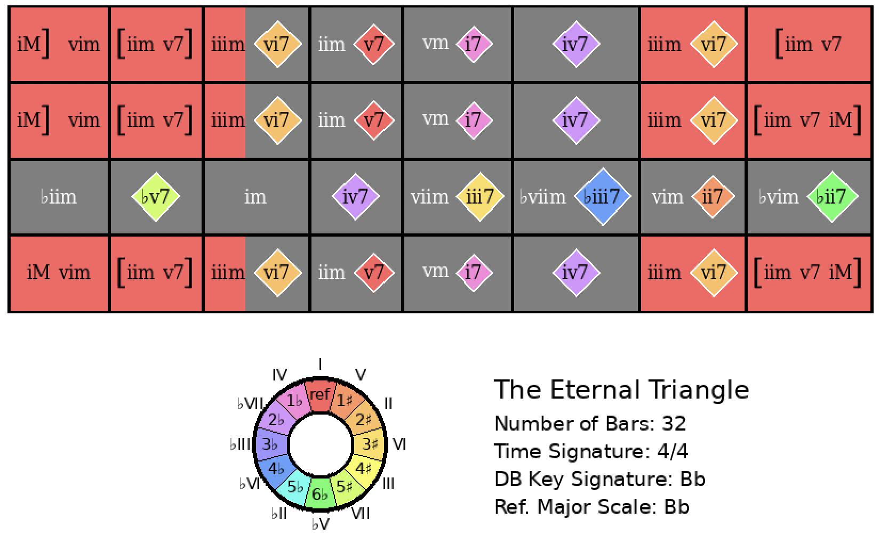
I Got Rhythm
Rank = 259, Area = 22.41

Slide 18
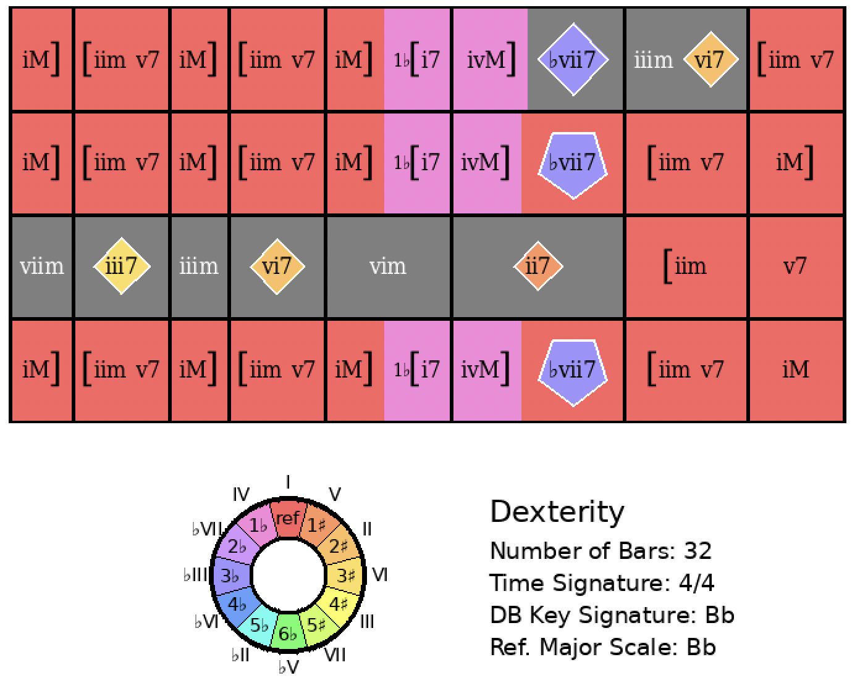
I Got Rhythm
Rank = 264, Area = 22.54

Slide 19
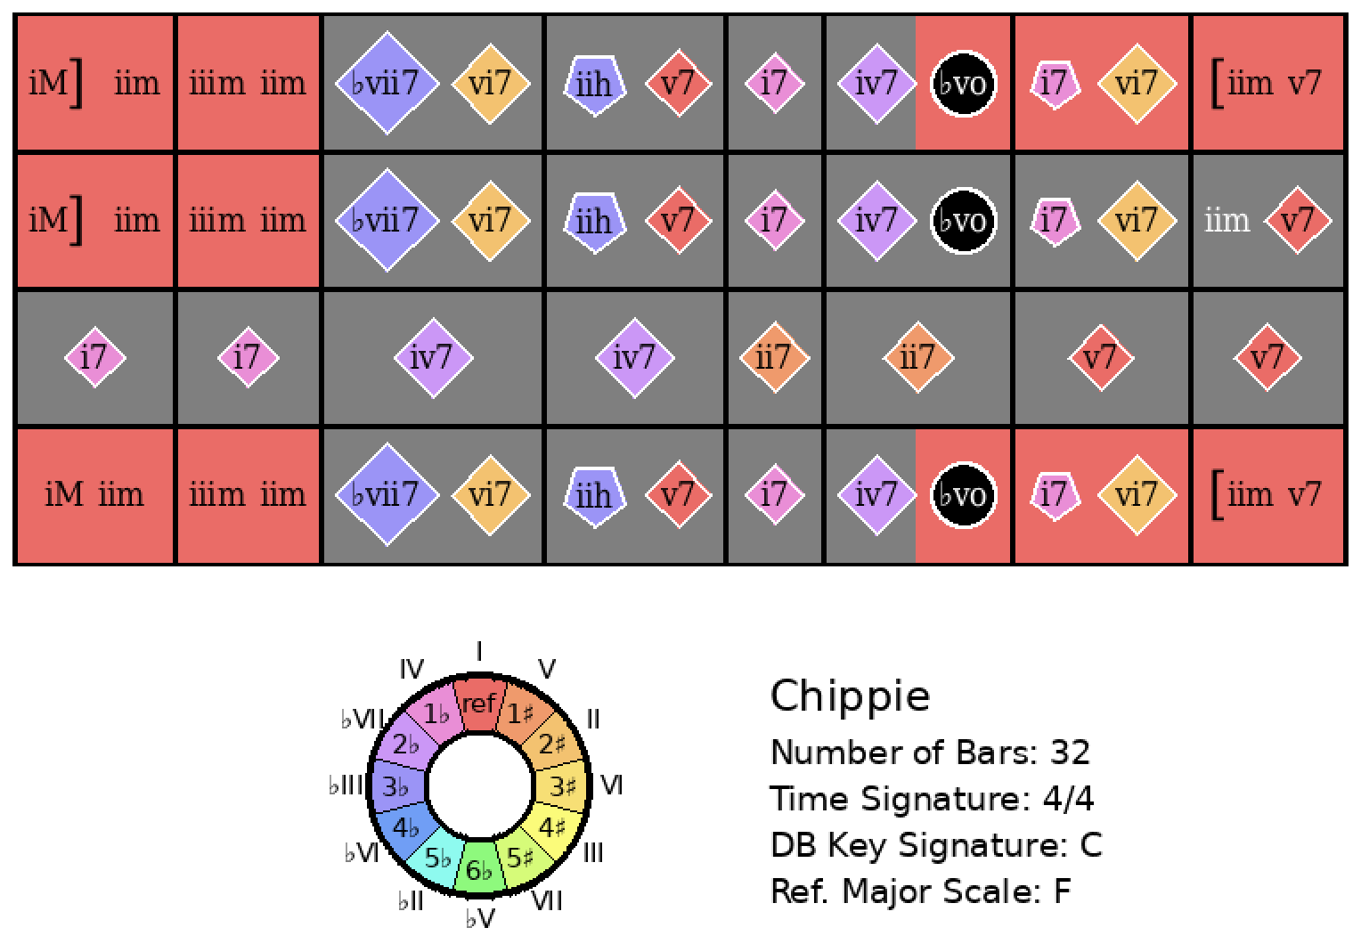
I Got Rhythm
Rank = 344, Area = 24.08

Slide 20
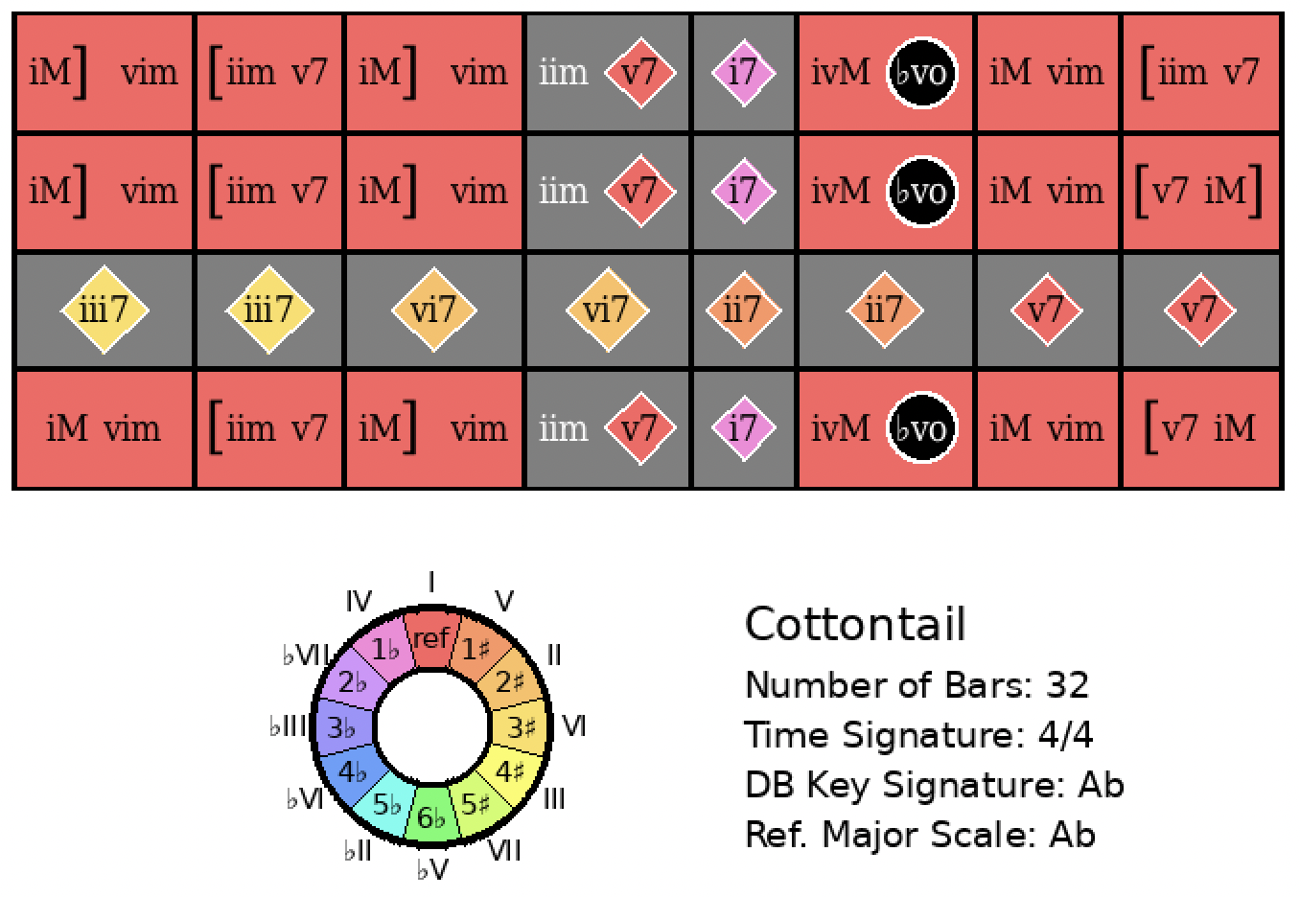
I Got Rhythm
Rank = 464, Area = 26.02

Slide 21
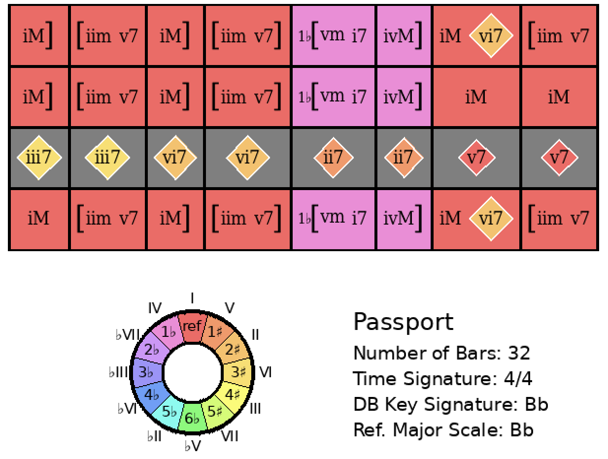
I Got Rhythm
Rank = 573, Area = 27.31

Slide 22
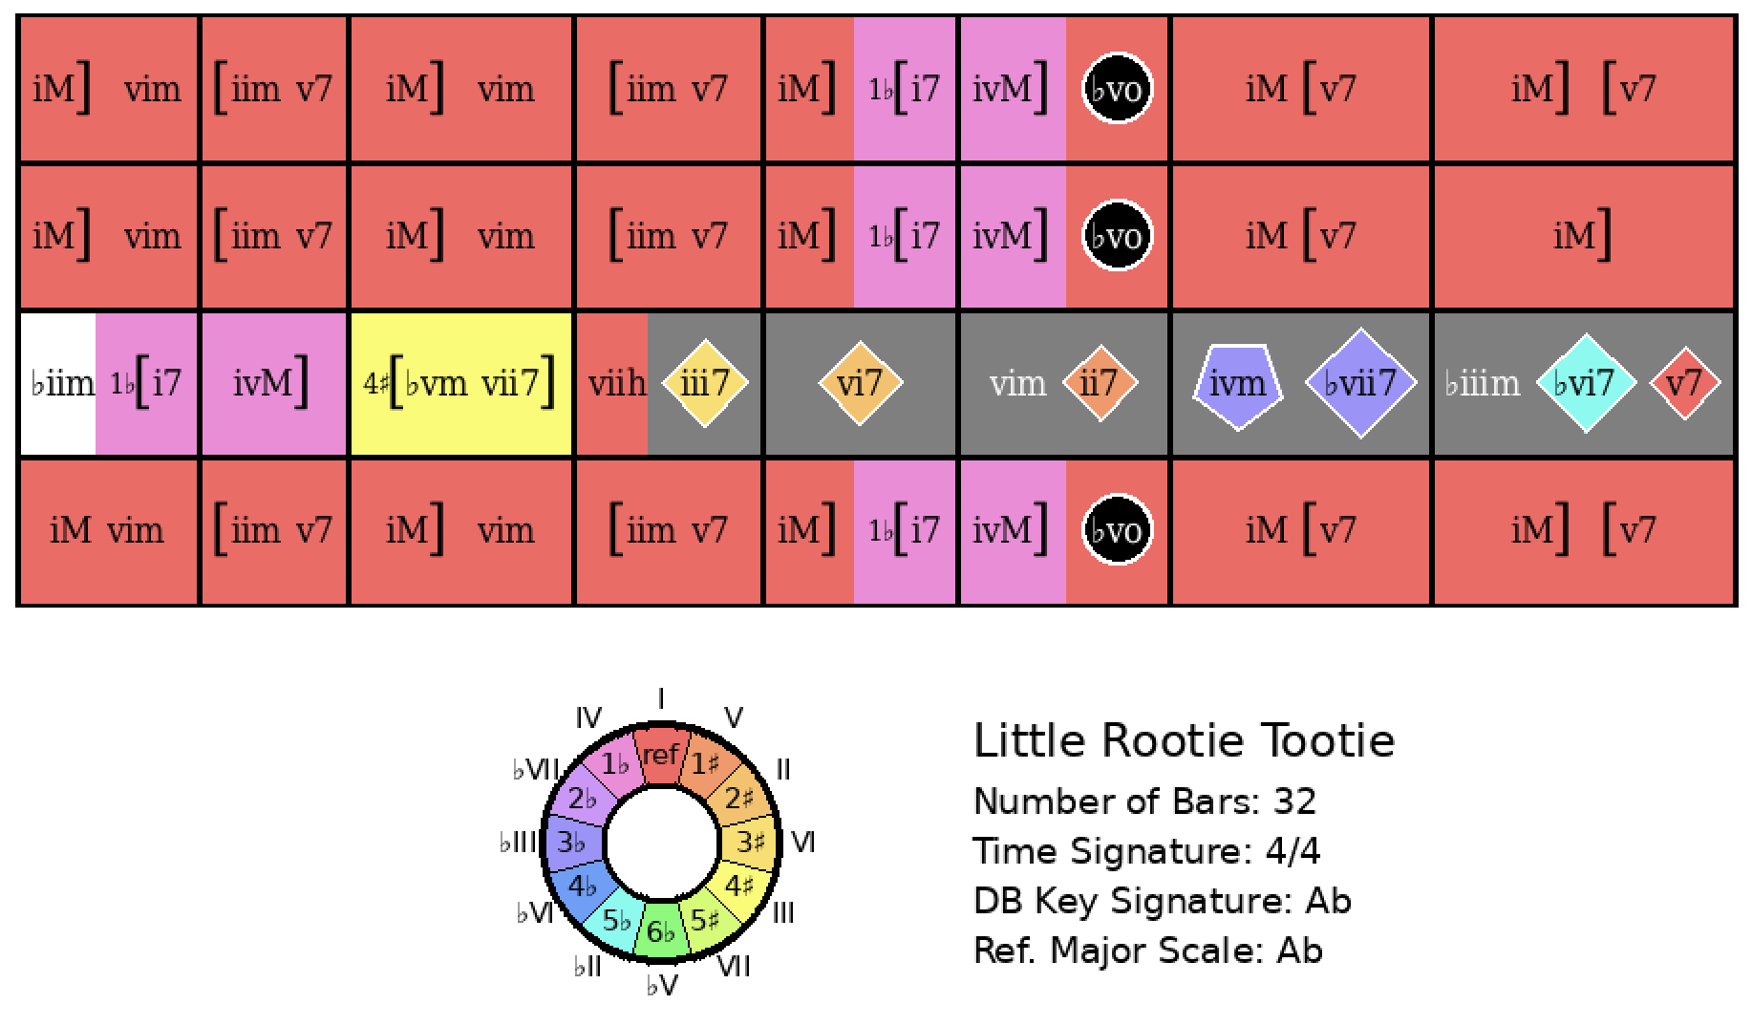
I Got Rhythm
Rank = 641, Area = 28.27

Slide 23
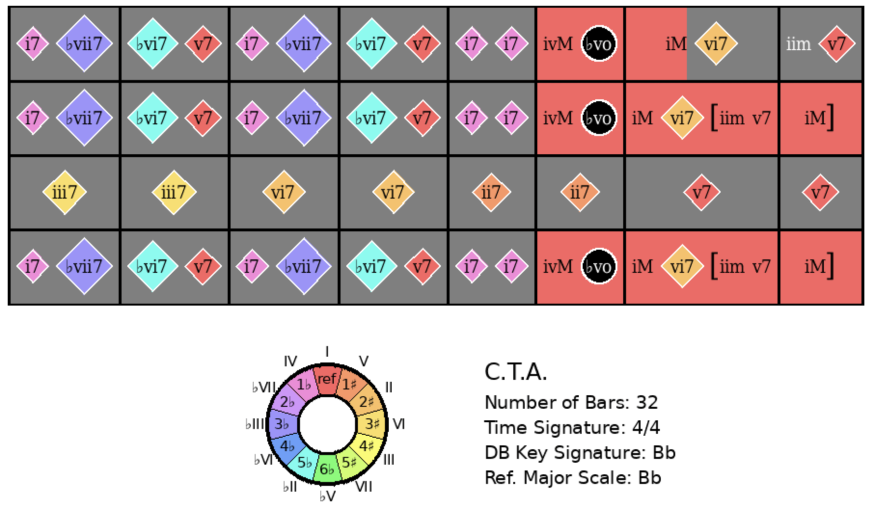
I Got Rhythm
Rank = 668, Area = 28.62

Slide 24
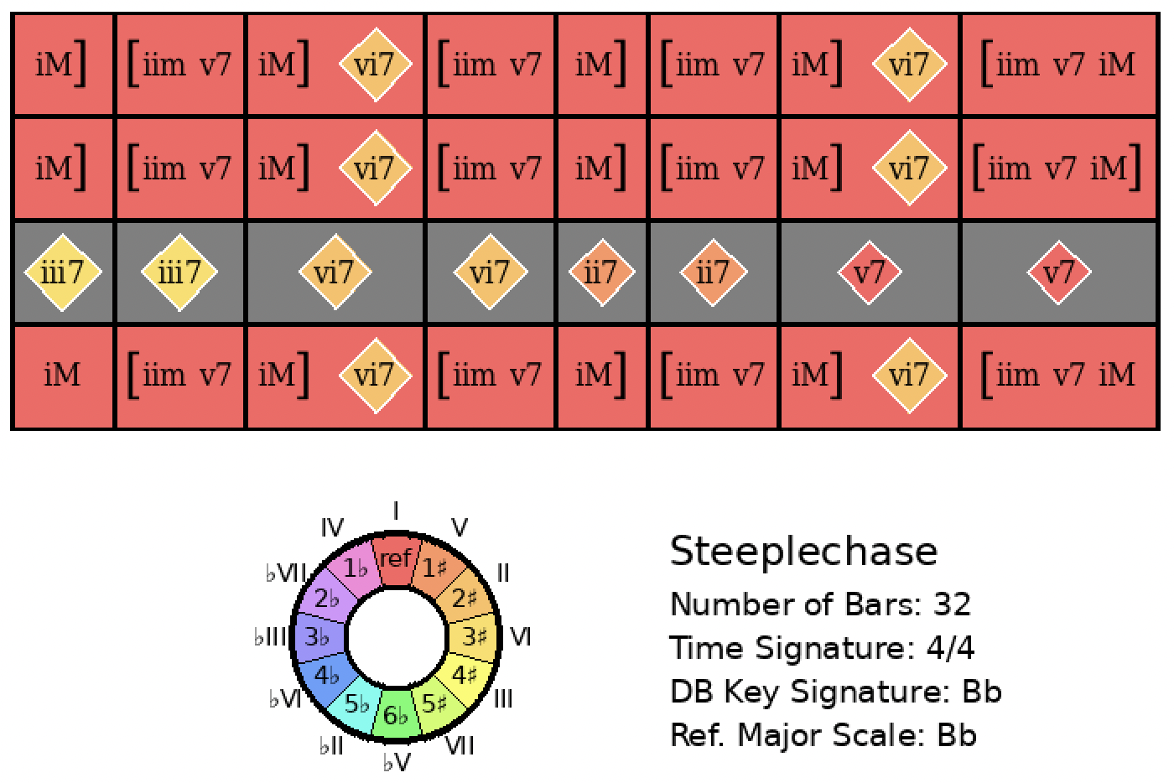
I Got Rhythm
Rank = 684, Area = 28.85

Slide 25
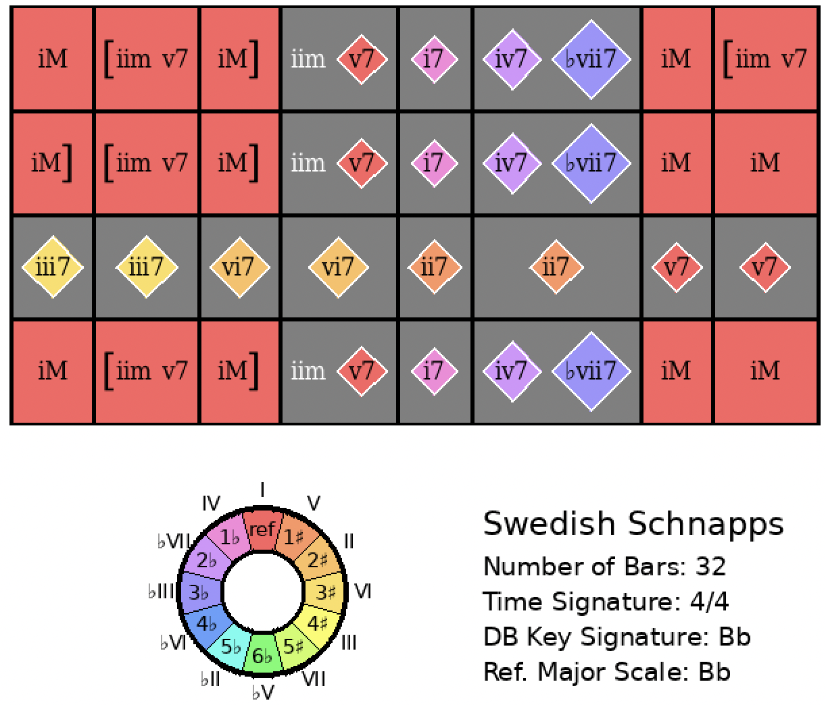
I Got Rhythm
Rank = 799, Area = 30.40

Slide 26
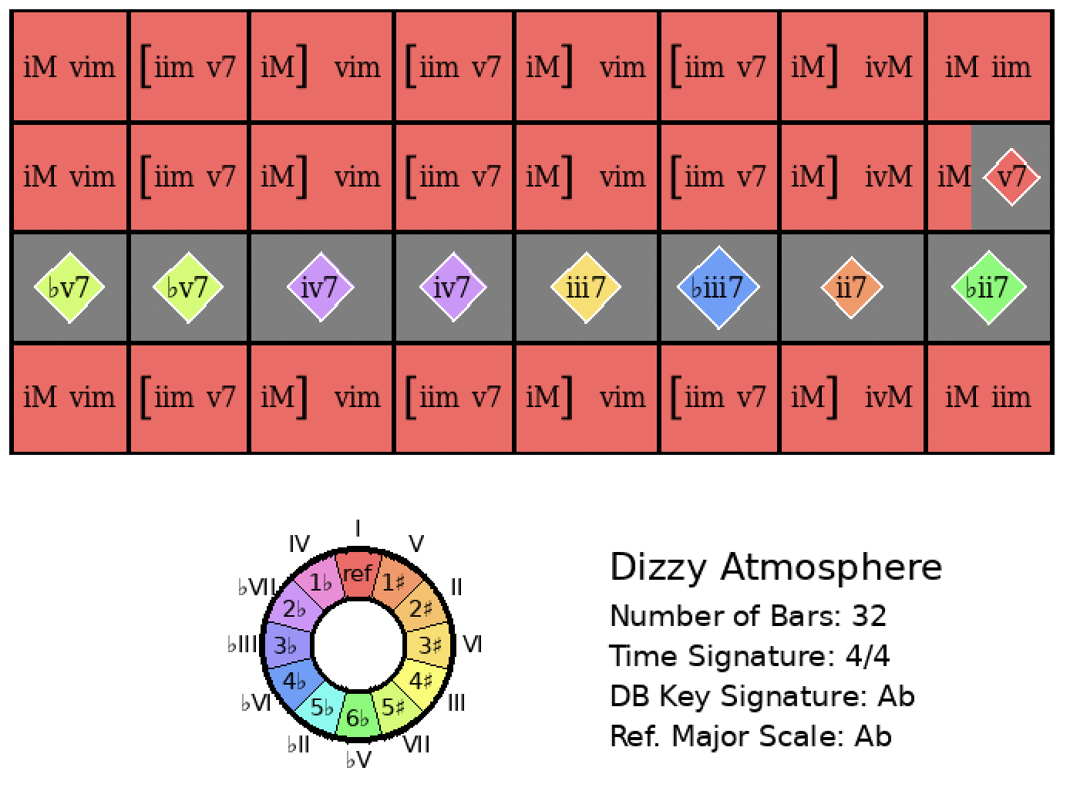
I Got Rhythm
Rank = 850, Area = 30.93

Slide 27
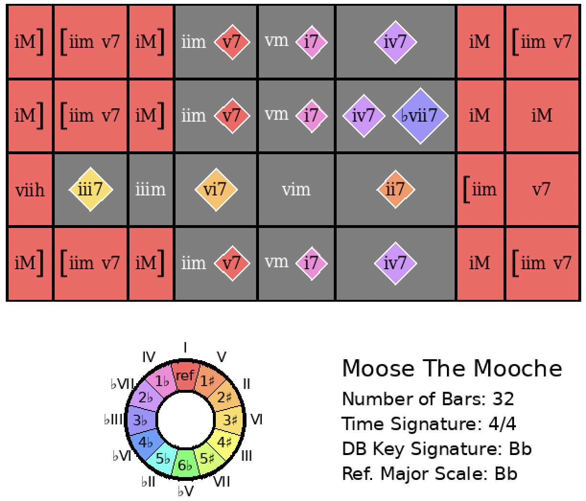
I Got Rhythm
Rank = 927, Area = 31.87

Slide 28
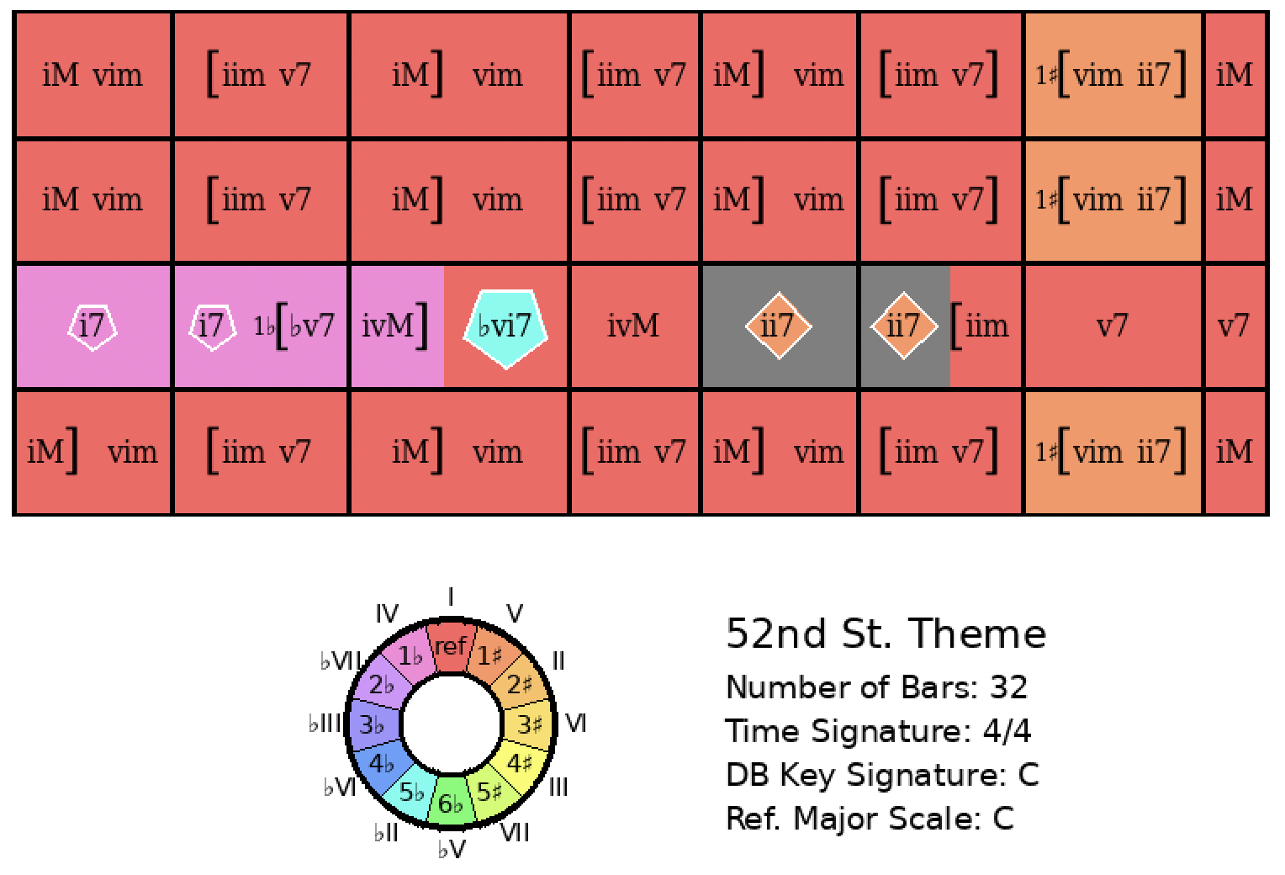
I Got Rhythm
Rank = 938, Area = 32.00

Slide 29
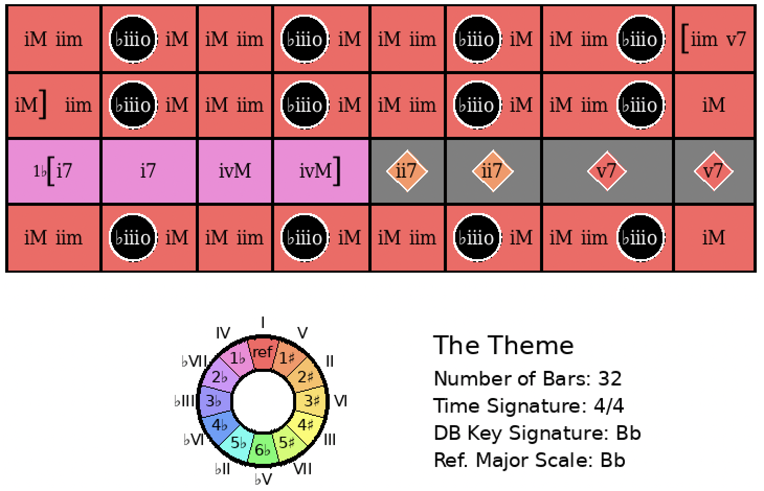
I Got Rhythm
Rank = 1033, Area = 33.15

Slide 30
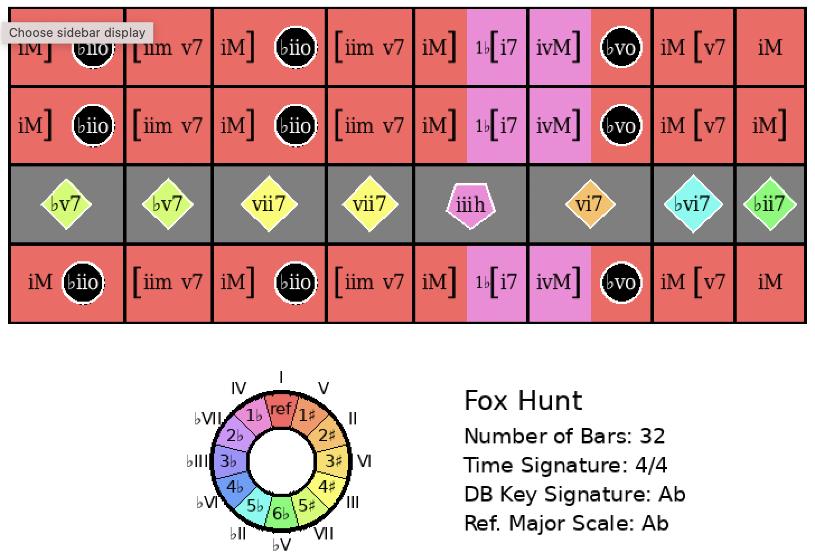
I Got Rhythm
Rank = 1115, Area = 34.17

Slide 31
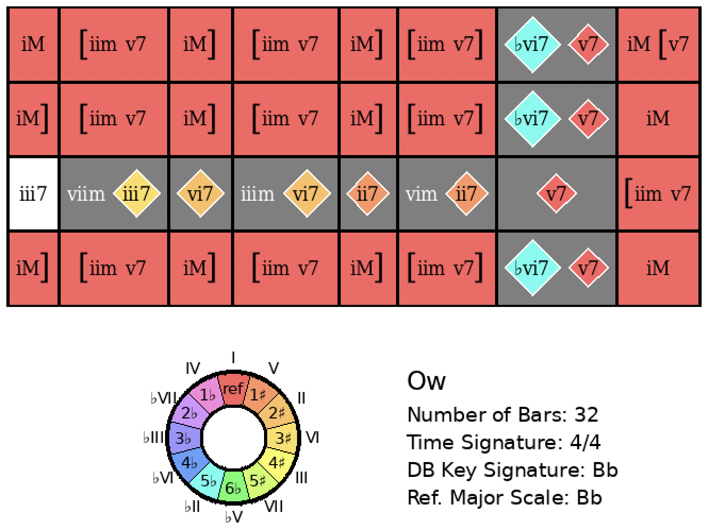
I Got Rhythm
Rank = 1356, Area = 37.08

Slide 32
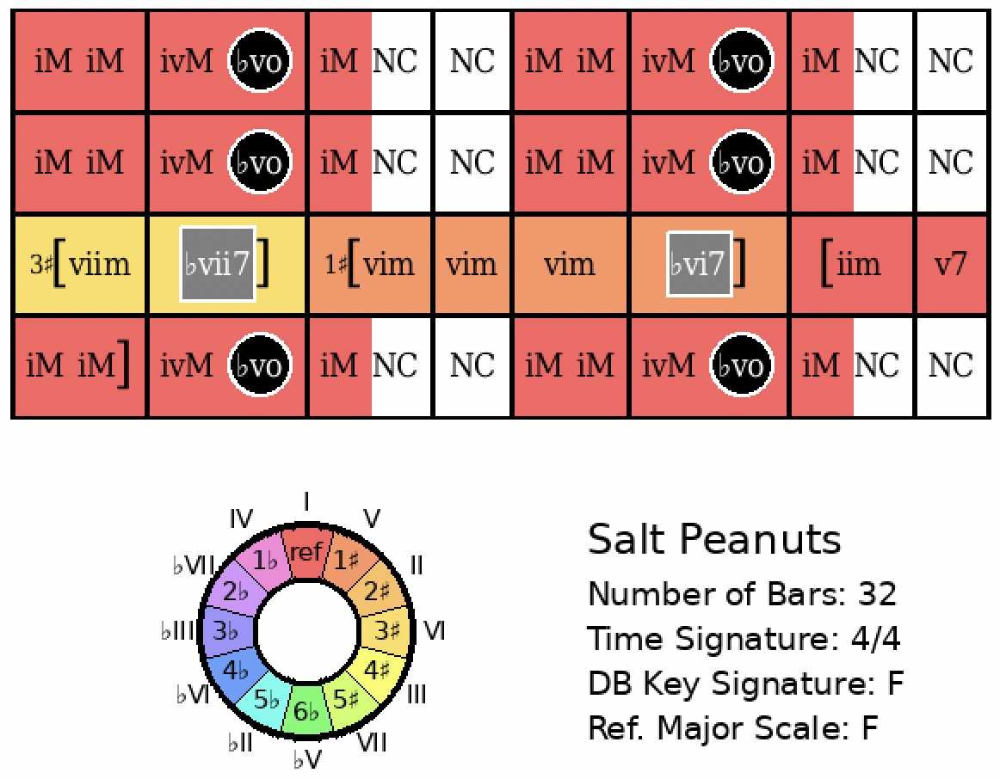
I Got Rhythm
Rank = 2388, Area = 59.68

Slide 33
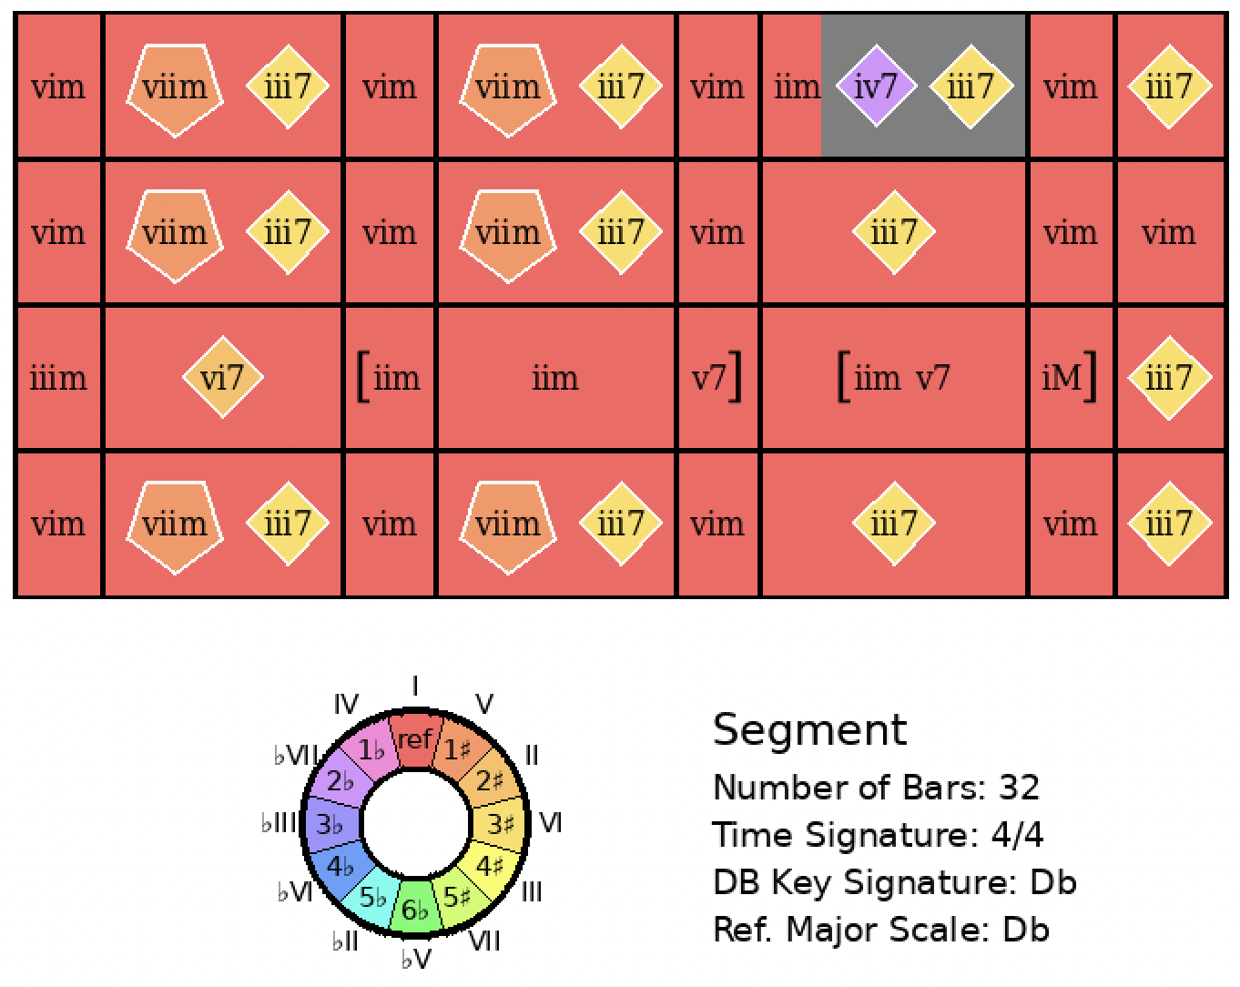
I Got Rhythm
Rank = 2562, Area = 78.15

Slide 34
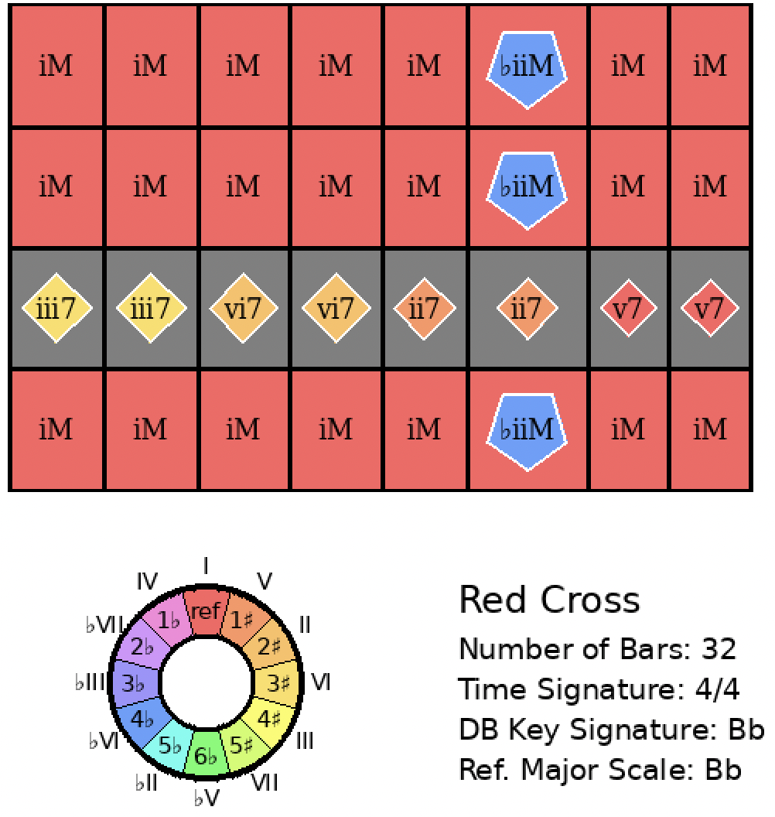
I Got Rhythm
Rank = 2577, Area = 81.77

